Slide 1
Computer Vision (Spring 2019) Problem Set #3
Jijun HU
jijun.hu.0930@gatech.edu
Computer Vision @ GT

Slide 2
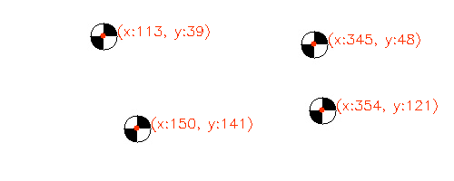
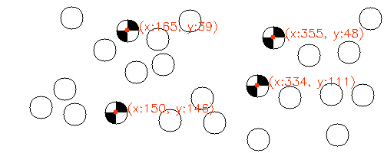
1: Marker detection
ps3-1-a-1
ps3-1-a-2
Computer Vision @ GT

Slide 3
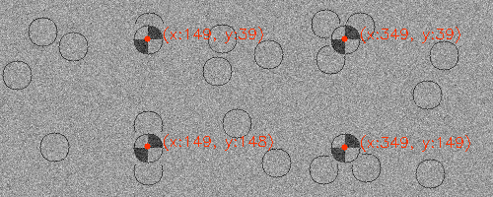
1: Marker detection (cont.)
ps3-1-a-3
Computer Vision @ GT

Slide 4
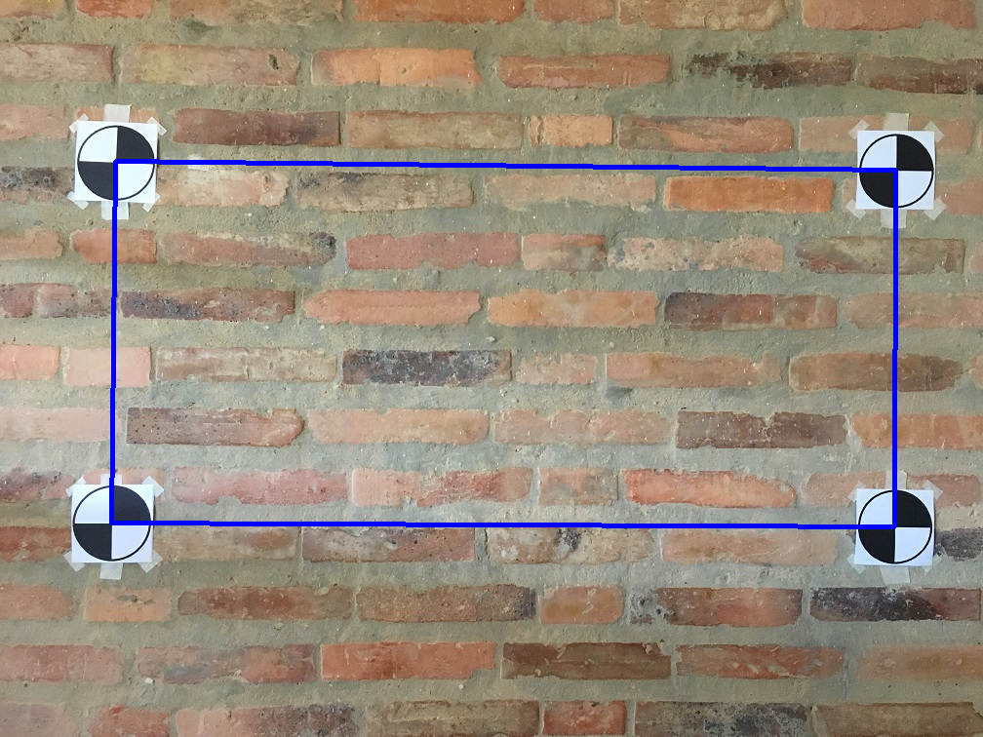
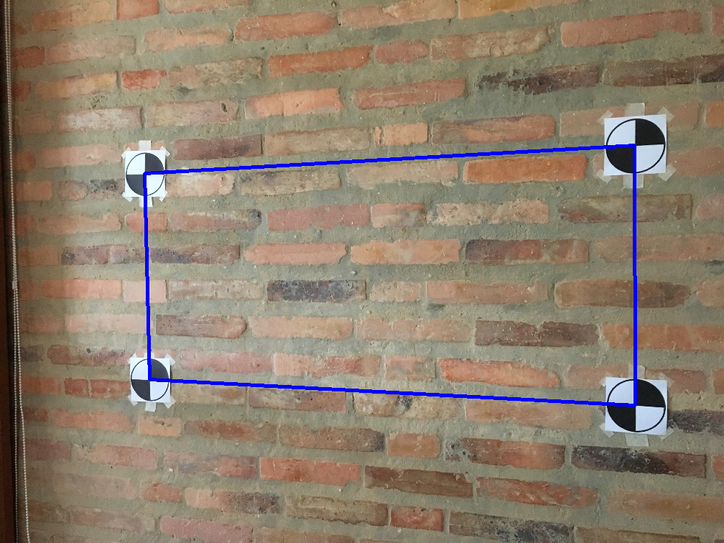
2: Marker detection (wall scene)
ps3-2-a-1
ps3-2-a-2
Computer Vision @ GT

Slide 5
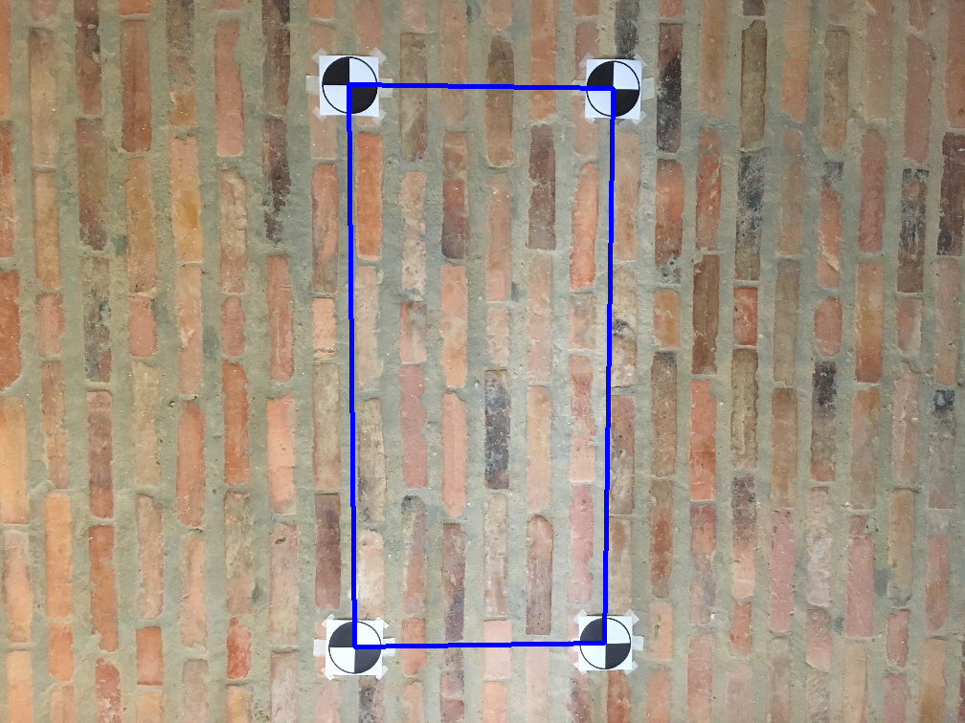
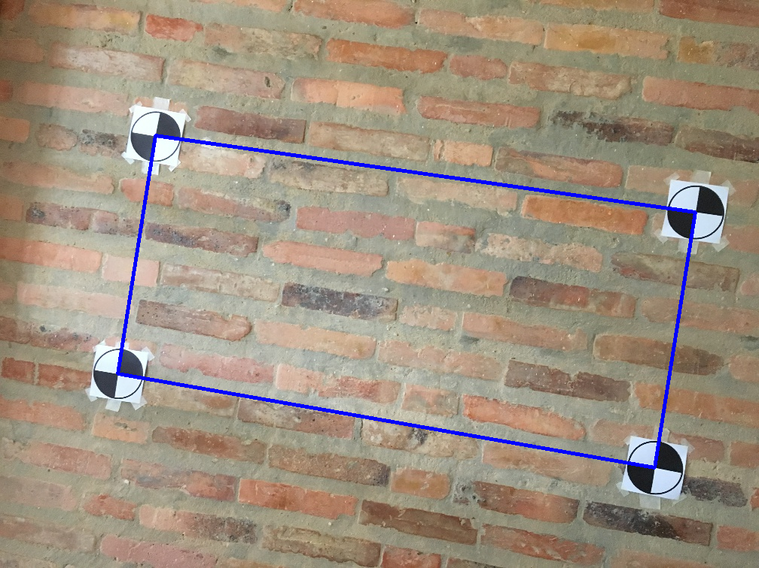
2: Marker detection (wall scene)
ps3-2-a-3
ps3-2-a-4
Computer Vision @ GT

Slide 6
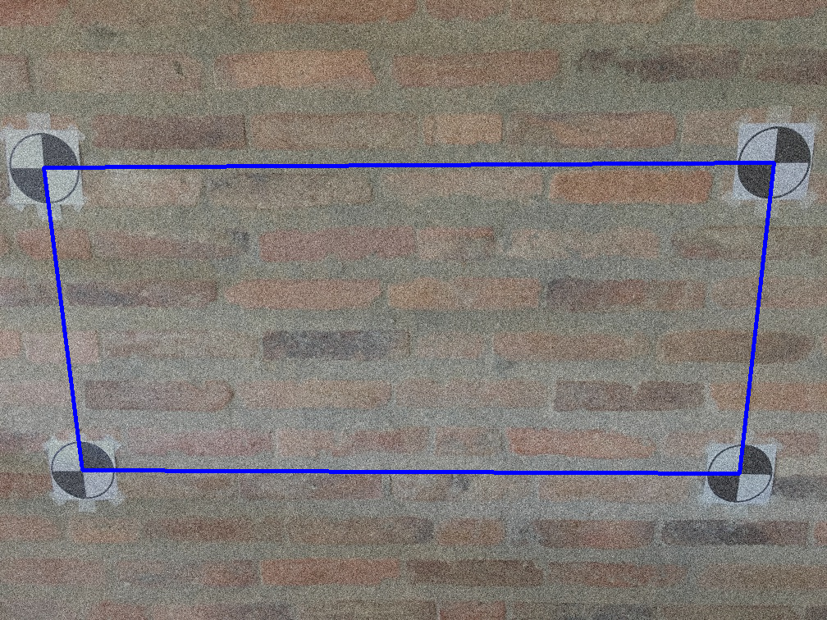
2: Marker detection (wall scene)
ps3-2-a-5
Computer Vision @ GT

Slide 7
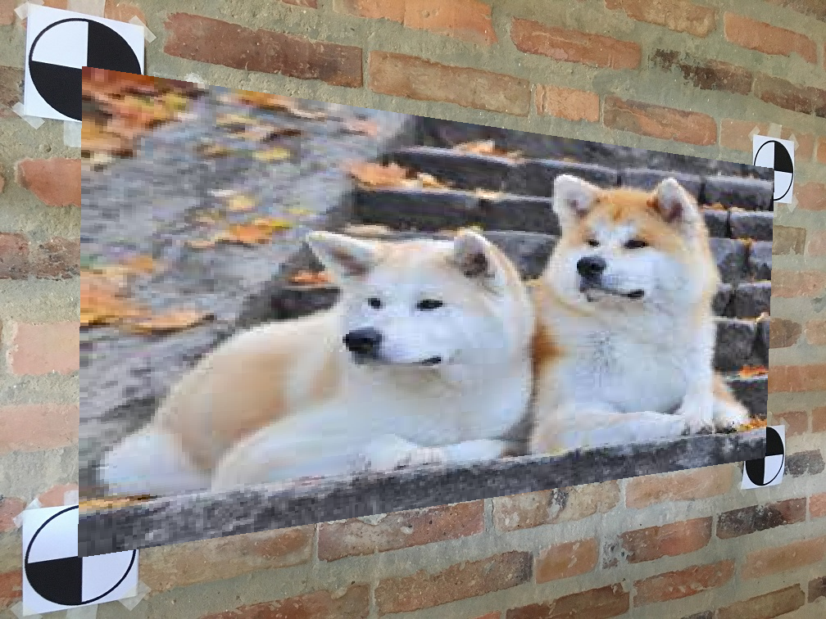
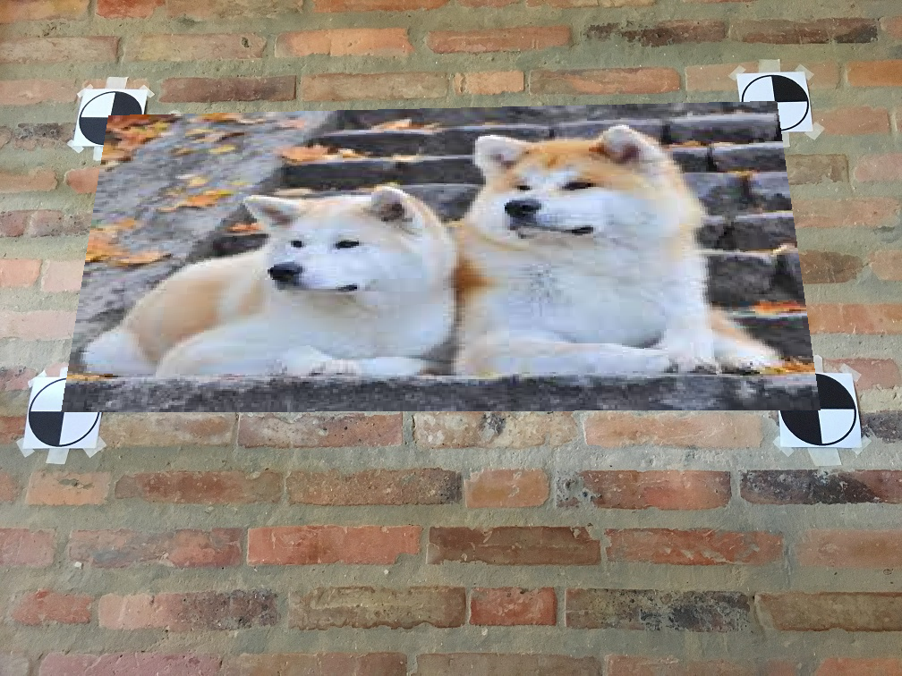
3: Projective Geometry
ps3-3-a-1
ps3-3-a-2
Computer Vision @ GT

Slide 8

3: Projective Geometry (cont.)
ps3-3-a-3
Computer Vision @ GT

Slide 9
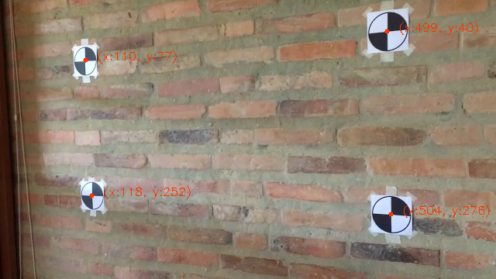
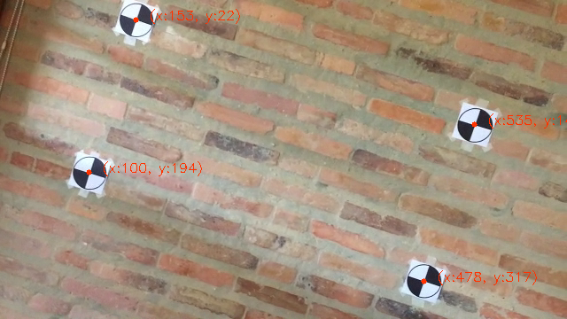
4: Markers in Video
ps3-4-a-1
ps3-4-a-2
Computer Vision @ GT

Slide 10
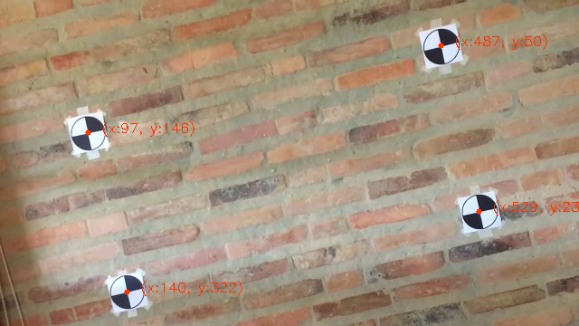
4: Markers in Video (cont.)
Youtube / Dropbox / etc. link:
https://www.dropbox.com/s/sbuv69aixgxc6xa/ar_4-a-ps3-4-a.mp4?dl=0
ps3-4-a-3
Computer Vision @ GT

Slide 11
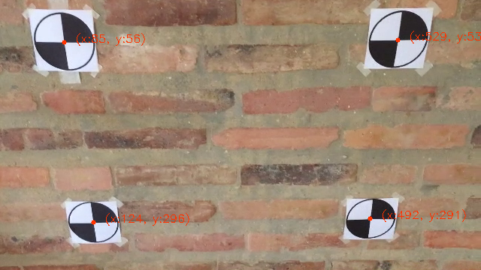
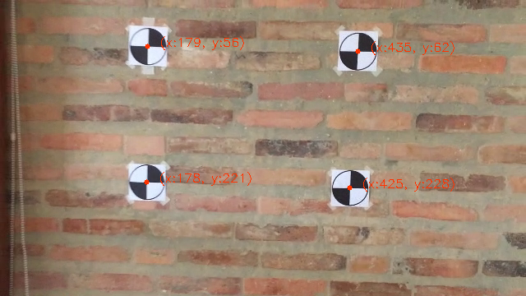
4: Markers in Video (cont.)
ps3-4-a-4
ps3-4-a-5
Computer Vision @ GT

Slide 12
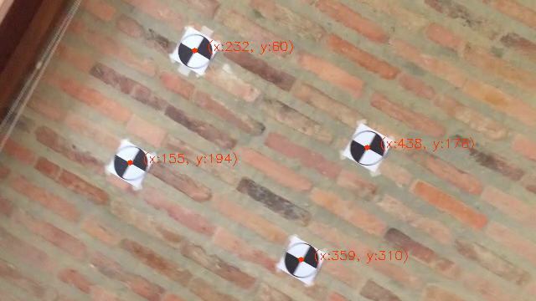
4: Markers in Video (cont.)
Youtube / Dropbox / etc. link:
https://www.dropbox.com/s/alk5hpr5djlhc2j/ar_4-a-ps3-4-b.mp4?dl=0
ps3-4-a-6
Computer Vision @ GT

Slide 13
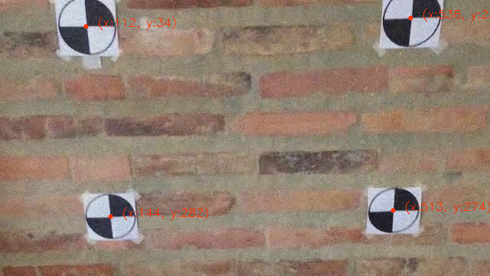
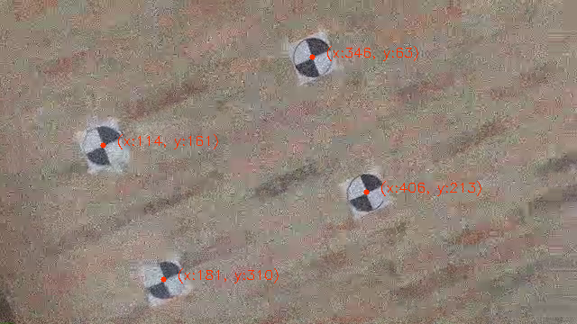
4: Markers in Video
ps3-4-b-1
ps3-4-b-2
Computer Vision @ GT

Slide 14
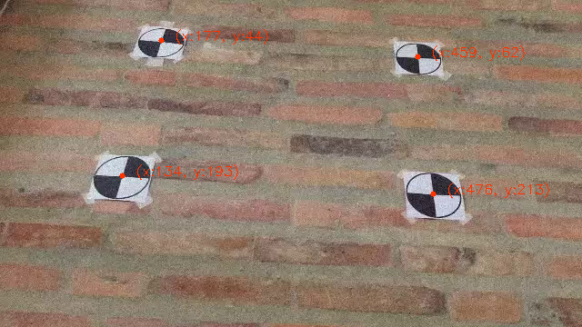
4: Markers in Video (cont.)
Youtube / Dropbox / etc. link:
https://www.dropbox.com/s/ugcmzany4l3yaaq/ar_4-b-ps3-4-c.mp4?dl=0
ps3-4-b-3
Computer Vision @ GT

Slide 15
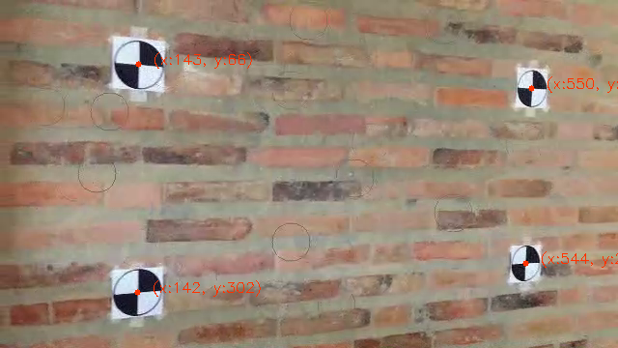
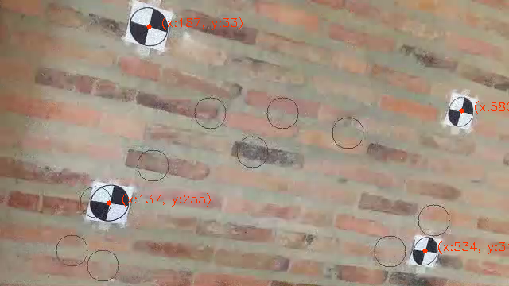
4: Markers in Video (cont.)
ps3-4-b-4
ps3-4-b-5
Computer Vision @ GT

Slide 16
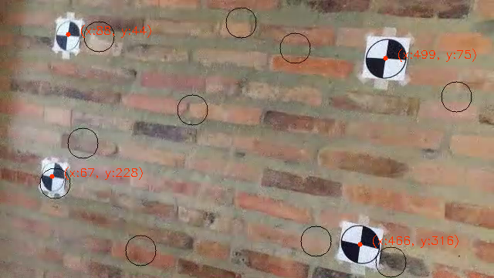
4: Markers in Video (cont.)
Youtube / Dropbox / etc. link:
https://www.dropbox.com/s/0p97dgdhpf1ejoq/ar_4-b-ps3-4-d.mp4?dl=0
ps3-4-b-6
Computer Vision @ GT

Slide 17
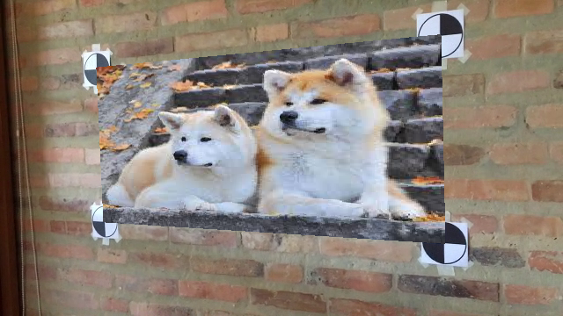

5: AR in Video
ps3-5-a-1
ps3-5-a-2
Computer Vision @ GT

Slide 18

5: AR in Video (cont.)
Youtube / Dropbox / etc. link:
https://www.dropbox.com/s/0mtx7buou1miplh/ar_5-a-ps3-4-a.mp4?dl=0
ps3-5-a-3
Computer Vision @ GT

Slide 19
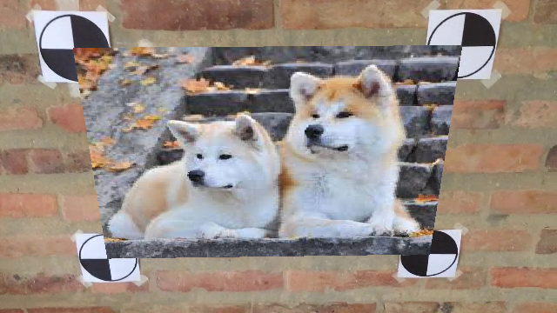
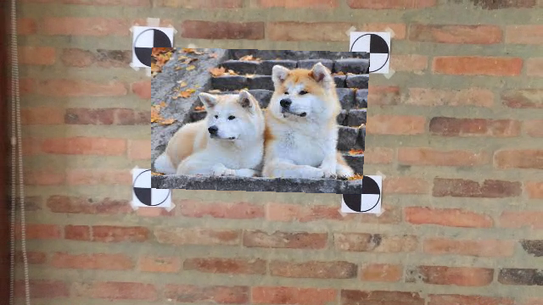
4: AR in Video (cont.)
ps3-5-a-4
ps3-5-a-5
Computer Vision @ GT

Slide 20
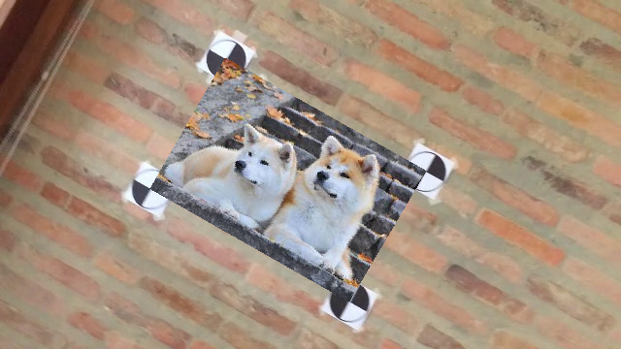
5: AR in Video (cont.)
Youtube / Dropbox / etc. link:
https://www.dropbox.com/s/platpc69y35w0a4/ar_5-a-ps3-4-b.mp4?dl=0
ps3-5-a-6
Computer Vision @ GT

Slide 21


5: Markers in Video
ps3-5-b-1
ps3-5-b-2
Computer Vision @ GT

Slide 22
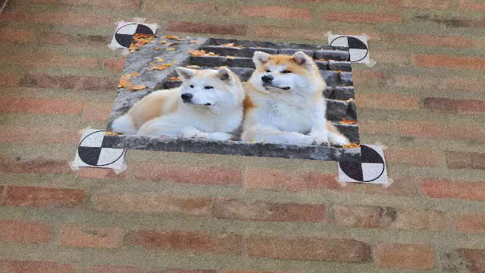
5: Markers in Video (cont.)
Youtube / Dropbox / etc. link:
https://www.dropbox.com/s/u1ut1zbn0shhmdy/ar_5-b-ps3-4-c.mp4?dl=0
ps3-5-b-3
Computer Vision @ GT

Slide 23


5: Markers in Video (cont.)
ps3-5-b-4
ps3-5-b-5
Computer Vision @ GT

Slide 24
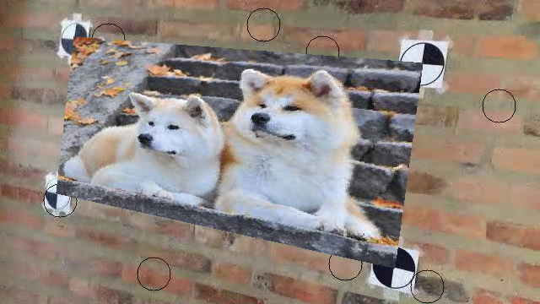
5: Markers in Video (cont.)
Youtube / Dropbox / etc. link:
https://www.dropbox.com/s/8bl18ycqtw10rrg/ar_5-b-ps3-4-d.mp4?dl=0
ps3-5-b-6
Computer Vision @ GT

Slide 25
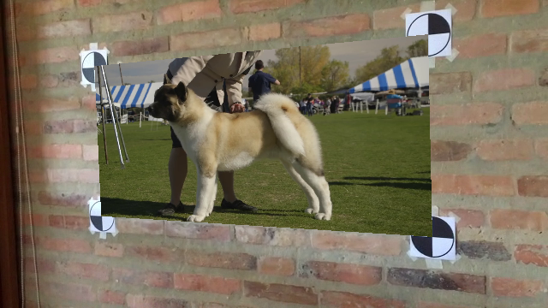
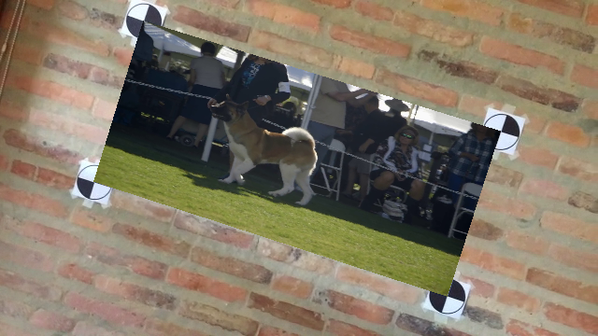
6: Video in Video
ps3-6-a-1
ps3-6-a-2
Computer Vision @ GT

Slide 26
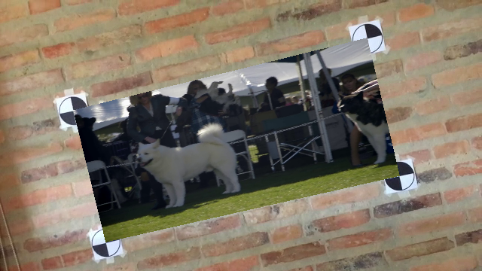
6: Video in Video (cont.)
Youtube / Dropbox / etc. link:
https://www.dropbox.com/s/9b5ochaptgbt47t/ar_6-ps3-4-a.mp4?dl=0
ps3-6-a-3
Computer Vision @ GT

